Slide 1
INSPARK PROJECT
TITLE :-COVID-19 BATTLE AND TRACKER
RISHINA SHARMA 1NT18IS125
K.S.SAIVAIBHAV 1NT18IS074
ABHISHEK ANAND 1NT18IS006
ABHISHEK SINGH 1NT18IS009

Slide 2
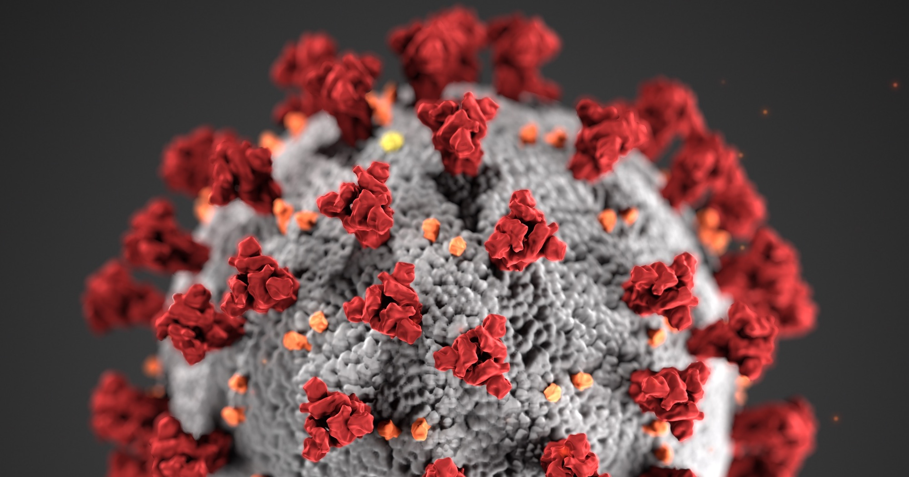
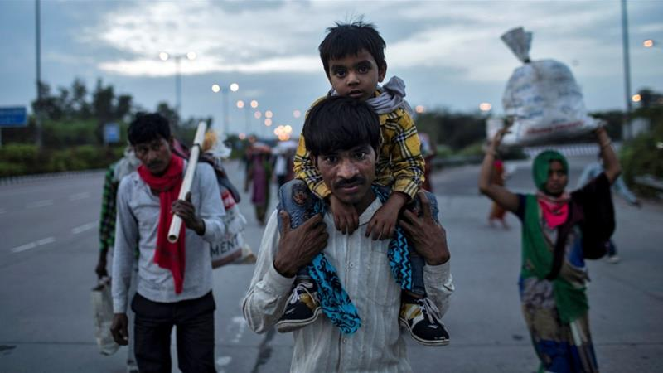
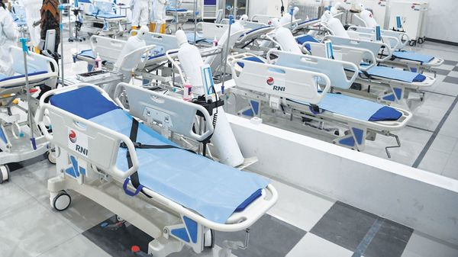

Slide 3
INTRODUCTION
As we are well aware, the world is in the brink of destruction caused by the pandemic outbreak covid-19 infected by corona virus.
The outbreak of coronavirus disease 2019 (COVID-19) has created a global health crisis that has had a deep impact on the way we perceive our world and our everyday lives
. Not only the rate of contagion and patterns of transmission threatens our sense of agency, but the safety measures put in place to contain the spread of the virus also require social distancing by refraining from doing what is inherently human of others.
Within this context of physical threat, social and physical distancing, as well as public alarm, what has been lacking from our government is TESTING cases. Without adequate testing prevention of this pandemic seems to be futile.
As a result to this, we have implemented a project using the concept of object oriented programming for testing more and more covid-19 cases.

Slide 4
OBJECTIVE
The main objective of our INSPARK project is to minimize the no. of cases by testing as many people and providing them pharmaceutical medical facility through our understanding of C++ programming.
In our project our main focus was to highlight the patient’s details such as his name, age, DOB, address, date and cause/reasons for his illness. Depending upon his particular illness he shall be declared as Corona positive or not.
Furthermore, if that person tests positive we will be showcasing a data analytics of each state of India affected by corona virus as each patient gets tested positive by incrementing the count.
We aim to provide immediate pharmaceutical medicine facility as well as display the immediate hospitals or clinics nearby where the person can immediately go and get his treatment. Thorough our project we aim to create awareness among people about corona virus urging them to take precautionary measures and not to panic under these circumstances
We also aim to spread awareness about this pandemic through a user friendly website.

Slide 5
SOTWARE IMPLEMENTATION
For software purposes we have used code blocks as the programming platform .
Our project contains 2 parts:
The database management and symptoms check system.
A user friendly website
Coming to the first part we have used C++ as the main programming language.C++ is a highly portable language and is often the language of selection for multi-device, multi-platform app development.
It is an object-oriented programming language and includes concepts like classes, inheritance, polymorphism, data abstraction, and encapsulation which allow code reusability and makes programs very maintainable.
C++ use multi-paradigm programming. The Paradigm means the style of programming .paradigm concerned about logics, structure, and procedure of the program. C++ is multi-paradigm means it follows three paradigm Generic, Imperative, Object Oriented.
It is useful for the low-level programming language and very efficient for general purpose.

Slide 6
The second part of the project is a website which is created using the languages like HTML and CSS and we have also used the concepts of bootstrap.

Slide 7
METHODOLOGY
Coming to the code ,for the first part we have used implemented the primary concept of classes and objects.
We have designed a structure for the patient’s details that a person will input each time the person logs in, then there are classes each for testing corona virus detection date of birth and for displaying software details.
In each of these there are data members as well as member functions designed for specific purposes.
By defining the accessibility or scope of these variables in various access specifiers such as private, protected and public we have implemented the concepts of inheritance and various oops concepts such as data abstraction, data encapsulation , data hiding and polymorphism i.e. one into many forms.
We have used object array for each patient to be tested and also the concept of default function arguments . Each time the user inputs each member function is called and consequently he will be tested. Overall our software implementation is a blend of classes and objection showcasing all oops concept.
For the second part as described earlier HTML is used to add features to website such as checking for symptoms and precautions.
We have also added buttons to which redirects to the official website of the Indian Health ministry to show the active cases per rigion

Slide 8
FUTURE IMPLEMENTATION We can definitely improve our piece of code by adding providing more techniques for testing as well as for prevention. We can build a system for providing essential goods and services for the people who are in need by tracking down their locations and helping them out in these adverse conditions. Moreover we can create awareness and educate the general public about this disease by creating proper websites. Considering the financial needs we can start urge people to donate money for the poor and the people who are affected by this crisis. In context with the programming we can add the concepts of file handling as well as virtual functions to improve our code.

